Slide 1
Game Theory
(Intermediate)
Arnob Sarker

Slide 2
Problem 1
Initially, there is a heap of stones on the table.
You and your friend will alternate taking turns, and you go first.
On each turn, the person whose turn it is will remove 1 to 3 stones from the heap.
The one who removes the last stone is the winner.

Slide 3
Game Theory problem identification
Two players, alternate turns
Finite game
Impartial

Slide 4
Problem 2 (Understanding winning state and losing state)
Given 2 piles of stones
Each player has to remove 1 or more stones from any one pile
The player who can not move loses

Slide 5
Nim Game
Given N piles of stones
On one move each player has to remove 1 or more stones from any one pile
The player who can not move loses

Slide 6
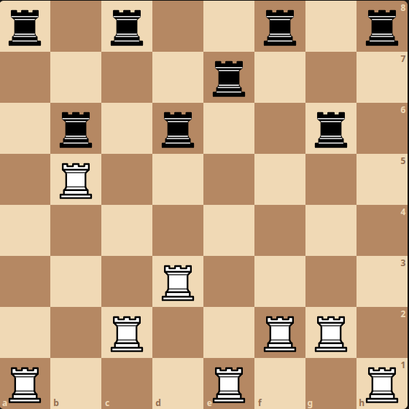
Rooks on a chess board
Given N*N chessboard with N white rooks and N black rooks
Each player has to move one of his colored rooks forward
The player who can not move loses

Slide 7
Misère Nim
Given N piles of stones
On one move each player has to remove 1 or more stones from any one pile
The player who can not move wins

Slide 8
Bogus Nim
Given N piles of stones
On one move each player has to remove 1 or more stones from any one pile
On one move each player can add some limited number of stones to any one pile
The player who can not move loses

Slide 9
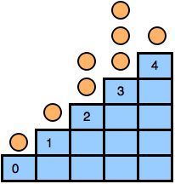
Staircase Nim
there is a staircase with n steps, indexed from 0 to n - 1
In each step, there are zero or more stones
On one move a player can chose a step i > 0 and move one or more coins to step i - 1
The player who can not move loses

Slide 10
Problem with coins
there are some coins in a 1d grid
In each move, one player can choose a coin and move it one or more cell to the left
Coins can not overlap or overtake another
The player who can not move loses

Slide 11
Problem strikes again
Given N piles of stones
On one move each player has to remove 1 or more stones from any one pile but at max n/2 stones
The player who can not move loses

Slide 12
Sprague-Grundy Theorem
Every impartial game under the normal play convention is equivalent to a one-heap game of nim
Grundy Number is equivalent to one nim pile
Play the first game with n piles
Grundy Number = Every tree = one nim pile = tree root value; tree leaf value = 0; tree node value = mex of all child nodes.

Slide 13
A good day for another Problem
Given N piles of stones
On one move each player has to split any 1 pile into two unequal piles of stones
The player who can not move loses
[Careful:(when xor when mex) one tree node can become multiple new tree roots (multiple elements in one node), then the value of that node = xor of all those root values]

Slide 14
Problem
Given a tree
On one move each player has cut an edge and the subtree would be disconnected
The player who can not move loses

Slide 15
Green Hackenbush on Tree
Colon Principle:
G(u) = (G(v1)+1) xor (G(v2)+1) xor … [v1, v2,... are childs of u]
For multiple trees ans is their xor

Slide 16
Problem with coins 2
Given 2d grid with n coins
On one move each player has to choose a coin then either
Move the coin up
Move the coin left
Or remove the coin from the grid
The player who can not move loses
 | 0 |  | 0
 |  | 0
0
 |  |  |  | 0

Slide 17
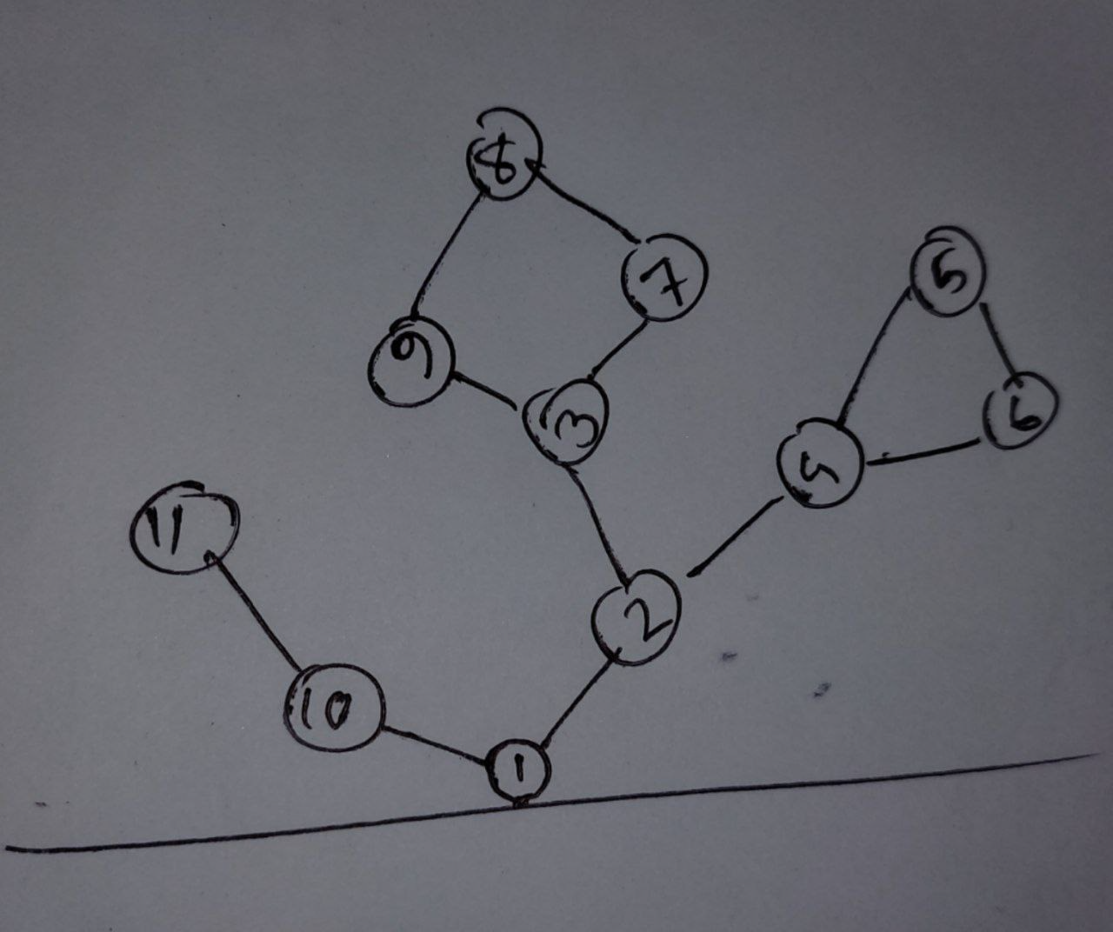
Problem
Given a connected graph
Assign some node as root which is connected to ground
On each move a player has to cut an edge
All the nodes that becomes disconnected from the root after the cut are removed.
The player who can not move loses

Slide 18
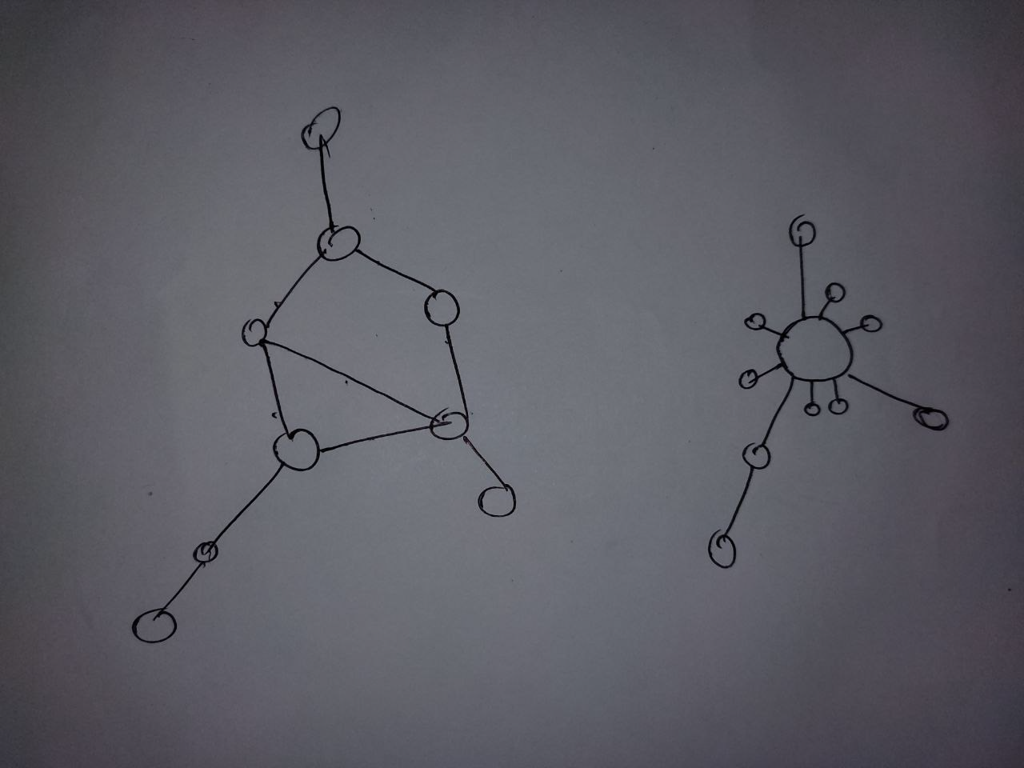
Green Hackenbush on Graph
Fusion Principle:
All edges in a cycle can be fused to get a tree structure; build a super node, connect some single nodes with that super node, number of single nodes is the number of edges in the cycle.
Solution: [Bridge component tree] mark all bridges, a group of edges that are not bridges, becomes one component and contributes number of edges to the hackenbush. (even number of edges contributes 0, odd number of edges contributes 1)

